Slide 1
Class 6

Slide 2

Do The Following
Turn video on
Type in chat or say:
Agree or disagree
Batman is a criminal
3. Click when done

Slide 3
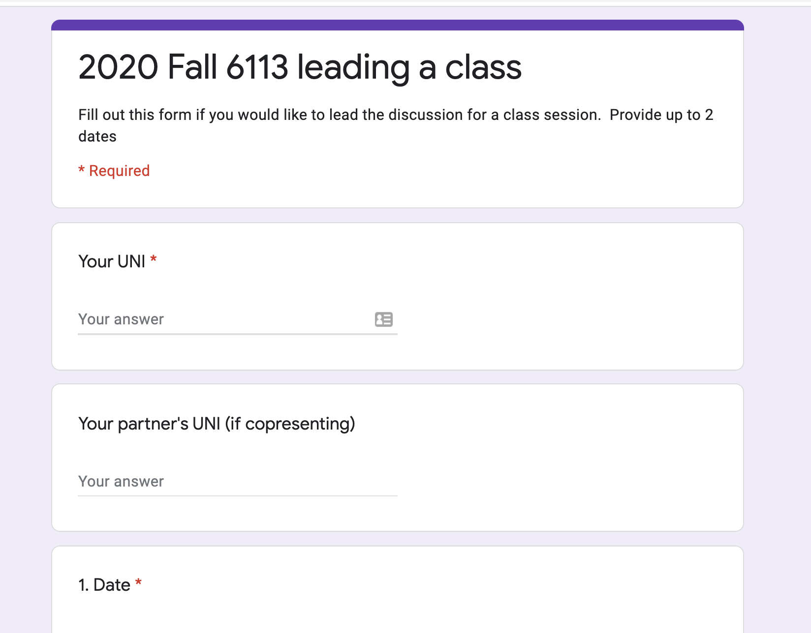
Logistics
Project proposals due 10/1
A2 due 10/4
Sign up to lead a class (link on website, slack)

Slide 4
DB seminar talks
9/29 Julia Stoyanovich (NYU)
Responsible Data Management
10/13 Wolfgang Gatterbauer (Northeastern)
QueryVis
10/20 Kostas Karanasos (Microsoft Gray Labs)
Lab overview + In-db ML inference
10/27 Vasiliki Kalavri (Boston U)
Streaming Research
11/10 Aaron Elmore (UChicago)
CrocodileDB
Zoom link in slack

Slide 5
Breakout Qs. Provide specific examples
G1 Writing: What did the paper focus on & not focus on? Why?
G2 Contribs: What is the main contribution?
Design an example that highlights it against prior work.
G3 Exps: Based on the paper’s aims, what exps should they have run? Did they? If not, design a specific exp they should have run.
G4 Future: Describe a major follow up question to study.
Each group assigns notetaker to report back (1m)

Slide 6
Breakout
Discussion:
Is a hot dog a sandwich? Discuss
Notetaker:
Summarize the discussion (~30s)

Slide 7
Class 5

Slide 8
Do The Following
Turn video on
Type in chat or say:
My favorite time of day is
___ ______
3. Click when done

Slide 9
Logistics
Today: multi-machine joins
A2 is out – optimizer!
A1 – what did you learn? What did you already know?

Slide 10
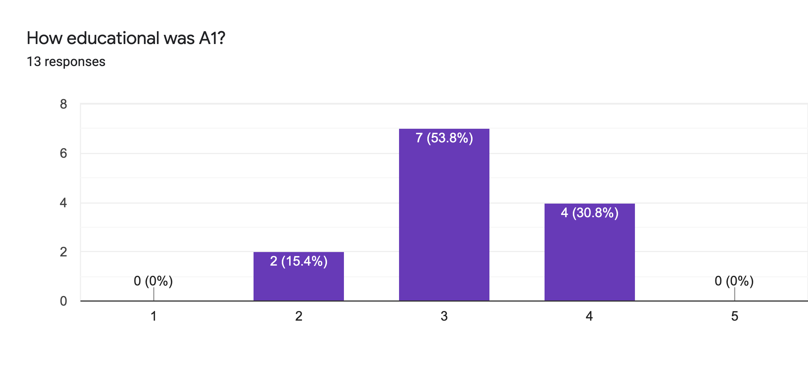
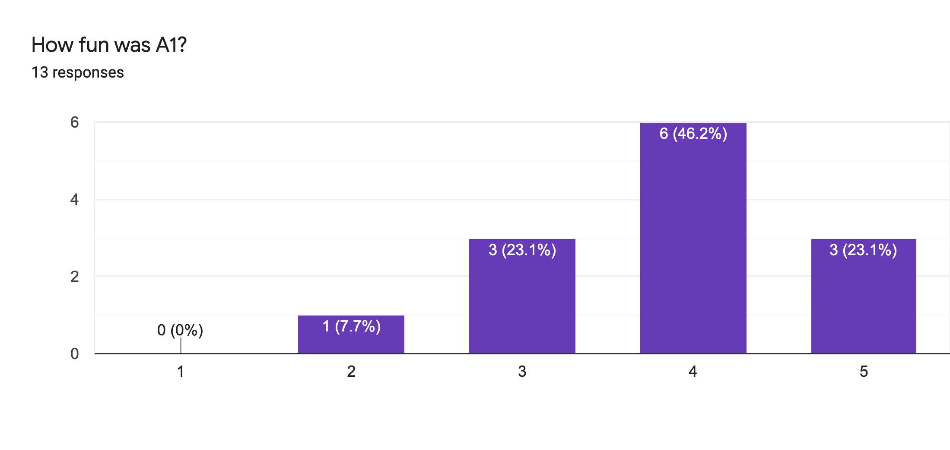
Main Comments
Vague Instructions
Bugs 🙏

Slide 11
Reviews
Strengths
Clear, honest writing
Ability to scale up/out is a big win!
Experiment design + explanation: A+

Slide 12
Reviews
Weaknesses
Lacks baselines
Aggregation?
Explain terms
How to choose partitioning key?
If scales to 1000+ nodes, what bottlenecks?
Failure on recovery?

Slide 13
Class 4

Slide 14
Do The Following
Turn video on
Type in chat or say:
A book/article I recently read
was ___ ______
3. Click when done

Slide 15

Today’s session
Finish previous class NO NEED!
Single Machine Joins.
Poll: paper reviews in pairs?

Slide 16
Today’s session
Finish previous class NO NEED!
Single Machine Joins.
Poll: paper reviews in pairs?
Poll: random pairing each week?

Slide 17
Breakout
Discussion:
Is a hot dog a sandwich? Discuss
Notetaker:
Summarize the discussion (~30s)

Slide 18
Discussion
Novelty
Theoretical guarantees
Experiment design

Slide 19
Class 3

Slide 20

Do The Following
Turn video on
Type in chat or say:
My favorite morning drink is ___ ___
(as much detail as you wish)
3. Click
Participants
Chat

Slide 21
Today’s session
Finish previous class
Multi-dimensional indexing
A1 is out, due 9/20

Slide 22
Breakout
Discussion:
Share your favorite quick cooking recipe,
or what you would like to cook
Notetaker:
Summarize the discussion (~30s)

Slide 23
Discussion
Novelty
Theoretical guarantees
Experiment design

Slide 24
Class 2

Slide 25
Turn video on,
enable mic & say:
“Hi, this is _(name)_,
I ate ___________ for breakfast”
Click when done
Participants
Chat

Slide 26
Logistics
Walk through
A0
Paper Reviews
Project list is up (still evolving)
Course goal
You feel comfortable reading papers + conducting research
Research ~ answering your own questions

Slide 27

Today’s session
Finish previous class
Review classic DBMS components
Notes on w6113.github.io

Slide 28
#ScholarStrike
Notes:
Supposed to be a two day strike where you don’t do any professor related tasks and learn about BLM and challenges of underrepresented people, and what can be done to help

Slide 29
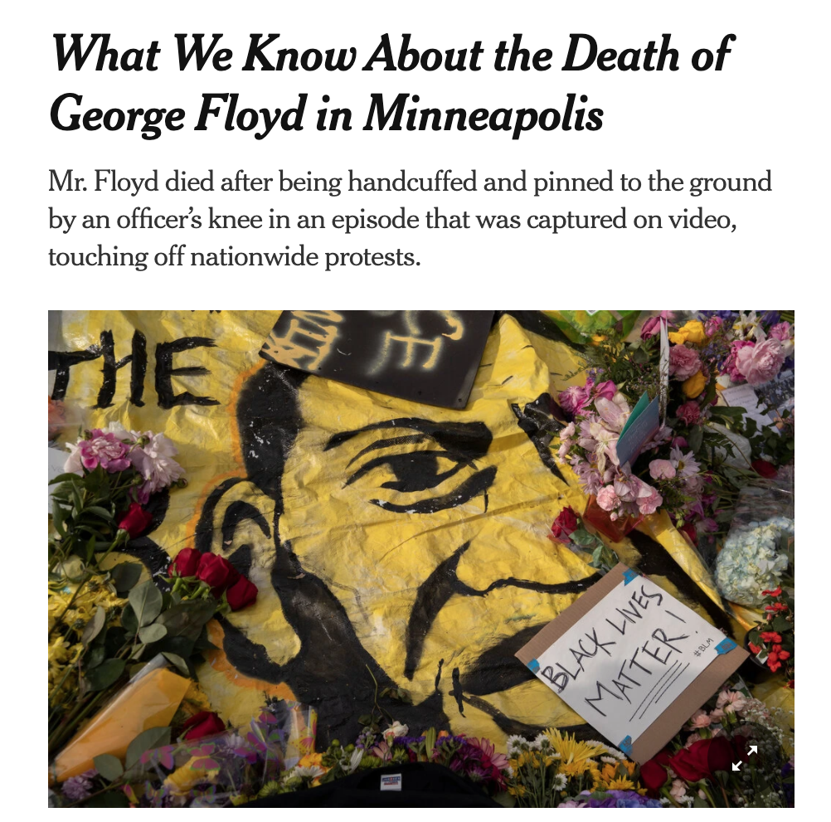
Black Lives Matter
Notes:
Discuss where all of this started and popularized this year, which, for me was the black lives matter protests.
BLM has been around for many years, but the very public, and unfair, murders of black people by police ignited the movement
For instance, geore floyd

Slide 30

Black Lives Matter
Notes:
Breonna Taylor was a nurse just at home in her apartment

Slide 31
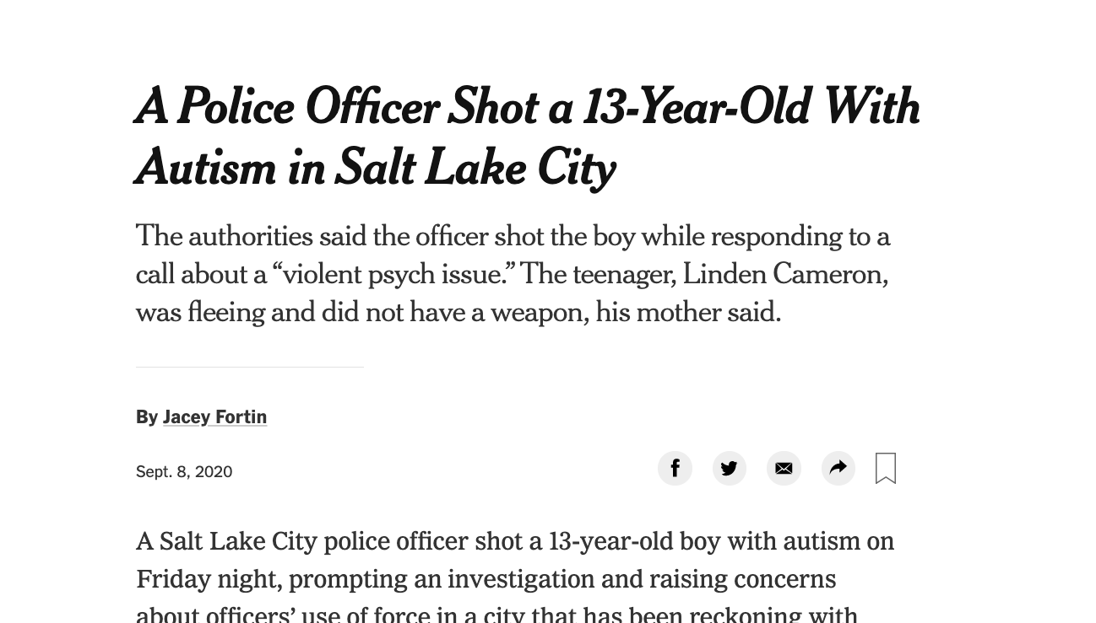
Black Lives Matter
Notes:
Linden Cameron was a 13 year old shot in the back

Slide 32

Black Lives Matter
Notes:
And Daniel Prude who was pinned and hooded by officers, who then blamed it on drug overdose, which leverages deep seated biases about black people.
These events are tragic, and simply symptoms of a deep disparity between African americans and the rest of America.
The US has historically treated immigrants of all kinds poorly, but African americans have been systematically oppressed from day one of the nation’s founding.
BLM is simply the manifestation of the outrage at this inequity

Slide 33

Notes:
Recently the WNBA led the sports world in going on a strike to further publicize this issue, and other sports leaguse followed.
ScholarStrike was a reaction by academics in support of this

Slide 34
Search terms to learn more
john oliver police
Netflix 13th
The case for reparations
shutdownstem
Notes:
Rather than cancel class, I’ll list here terms that are worth searching for to educate your self a bit about what’s going on. We will share these terms in the slack.
These are issues that I am not an expert in either, but I am happy to discuss these in recitation or OH.

Slide 35
Your Tasks for next class
Submit reviews for Tuesday
Submit Assignment 0 by 9/13 11:59PM EST
w6113.github.io

